Slide 1
IF 023 Java
Volodymyr Ostapiv
Olga Svyryd
Rostyslav Apostol
Sergii Zaiats
Andrius Omelchenko
Oleg Syvak
Ivan Duda
Sergii Lamanov
18.12.2012

Slide 2

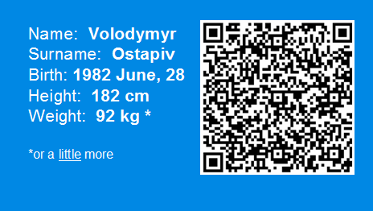
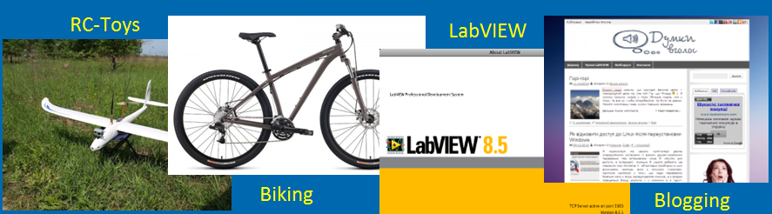
Volodymyr Ostapiv: About

Slide 3

First command task
Web server:
ensures smooth operation for 50 concurrent users;
handles request’s HTTP GET and POST methods;
works with html, htm, jpeg, jpg, png, gif, css, js formats;
stores data within a session and prevents data mixing;
supports clients sessions via cookies.

Slide 4
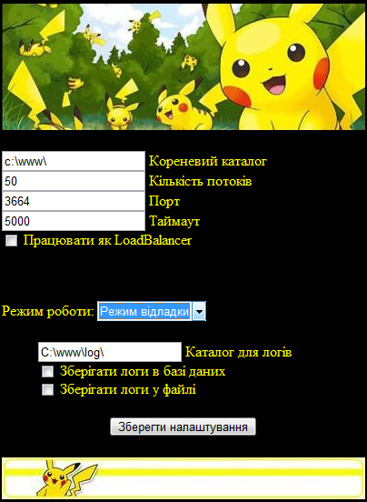
Pokémon WebServer
My Tasks
Server core : sockets
Multithreading
Tray icon
Html pages design (admin area, about page, etc.)

Slide 5






Team project: CVTracker
Powered by:
Works with sites:

Slide 6
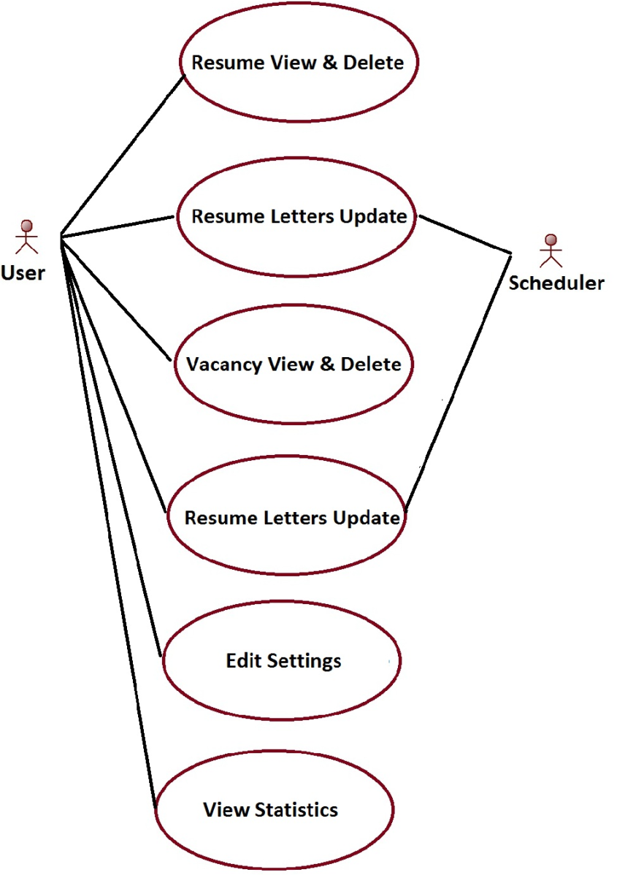
CVTracker functionality

Slide 7
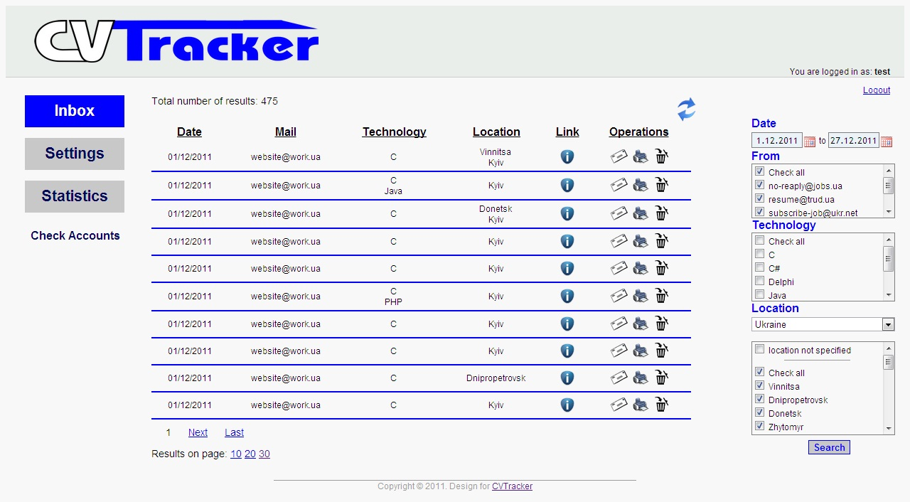
CVTracker: old view

Slide 8
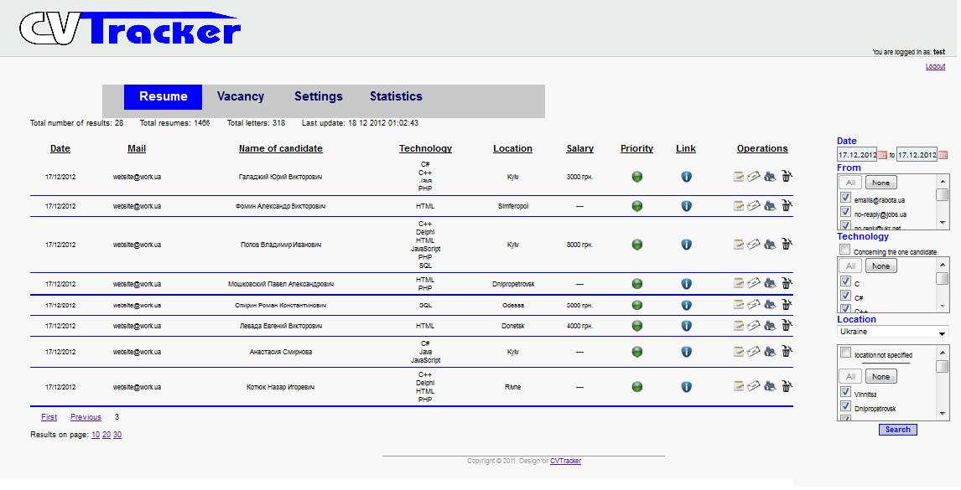
CVTracker: new view

Slide 9
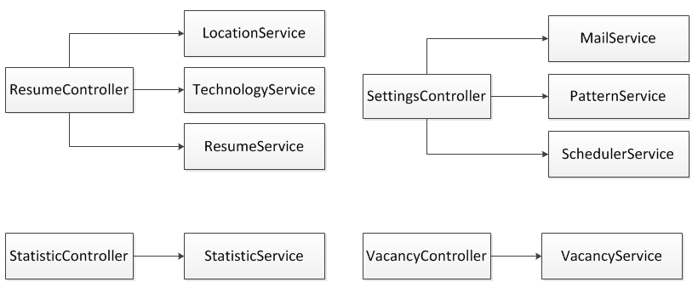
CVTracker: Controller → Service

Slide 10
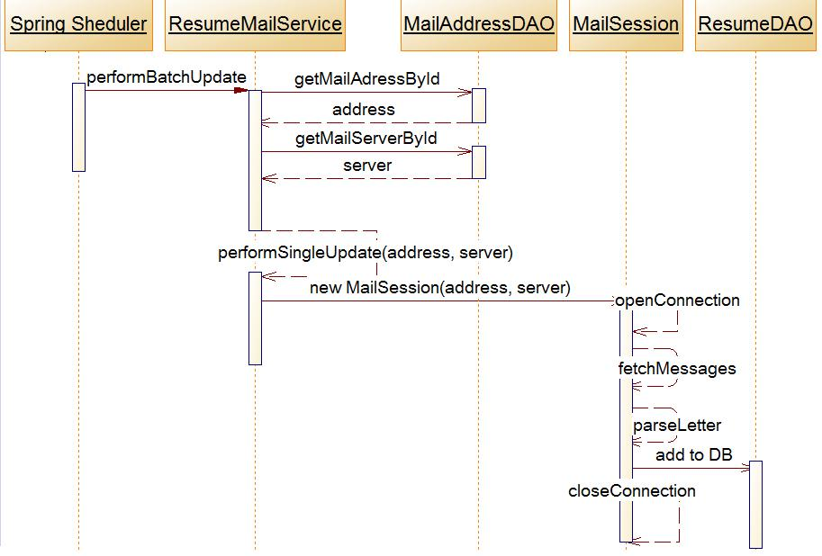
Scheduled letter update

Slide 11
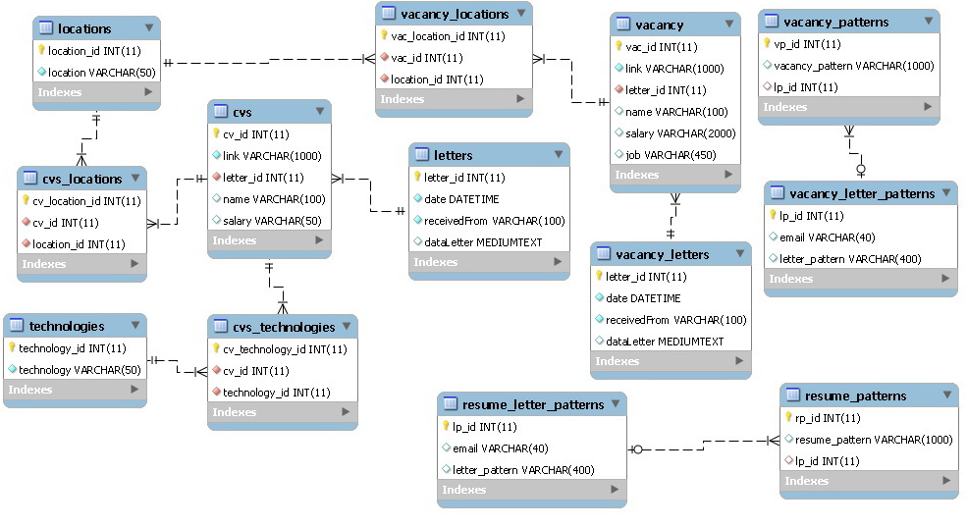


CVTracker: DB structure

Slide 12
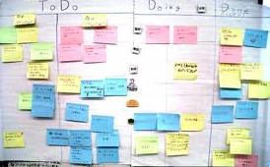
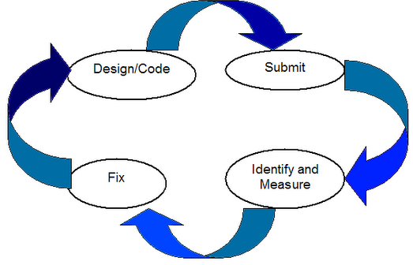
CVTracker tasks for IF-023
Statistics fixing;
Parsers creation;
Add validation for input fields;
Add screenshots to resumes and vacancies;
Implementing receiving letters with vacancies;
Add annotations to inbox.jsp and other tasks.
In total ~ 35 tasks!

Slide 13
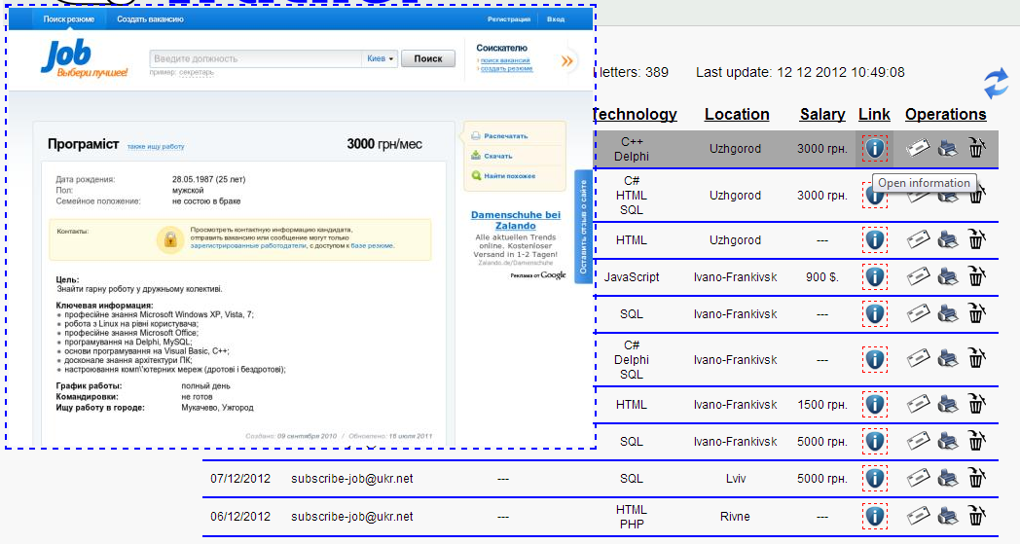
Pop-Up page preview
<script type="text/javascript">
$(document).ready(function(){
$('a.screenshot').hover(function(){
var path = $(this).attr('href');
$(this).append(‘
<div style="position:fixed; top: 10px; left: 10px; border:2px dashed blue;">
<img class="screenshot" src="http://mini.s-shot.ru/1024x768/600/jpeg/?'+path+'" align="right"/></div> ');
},
function(){
$('img.screenshot').remove();
})});
</script>
Pop-Up page preview
using remote web-service mini.s-shot.ru

Slide 14
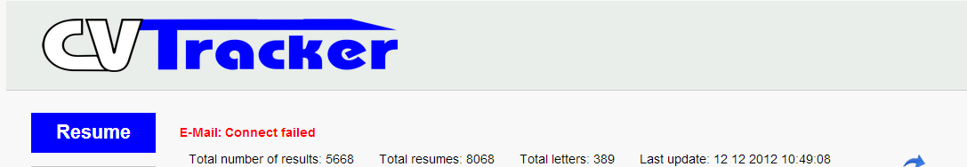
Error messages using AJAX
No Internet connection
Invalid e-Mail login/password
Restore from archive errors

Slide 15
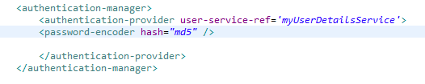
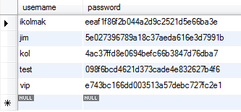
MD5 Authorization
MD5 Authorization with Spring Security

Slide 16
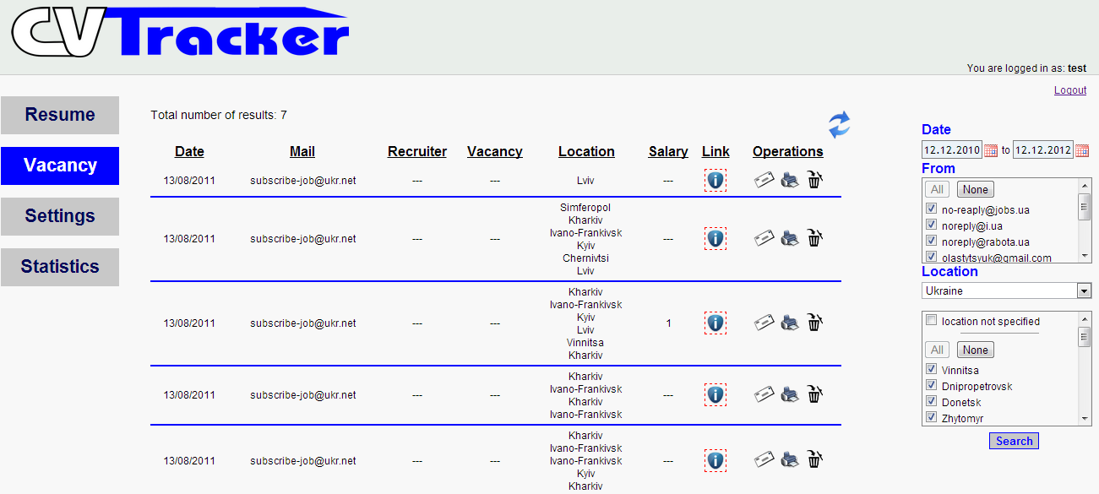
Vacancy page
Vacancy page added

Slide 17
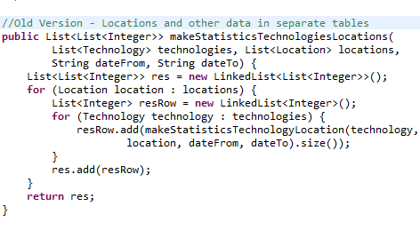
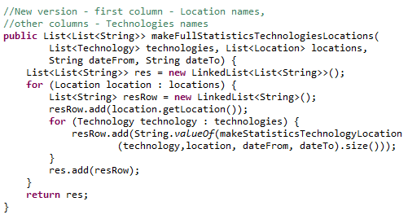
Statistics improvements
Statistics page business logic improvements
OLD
NEW

Slide 18
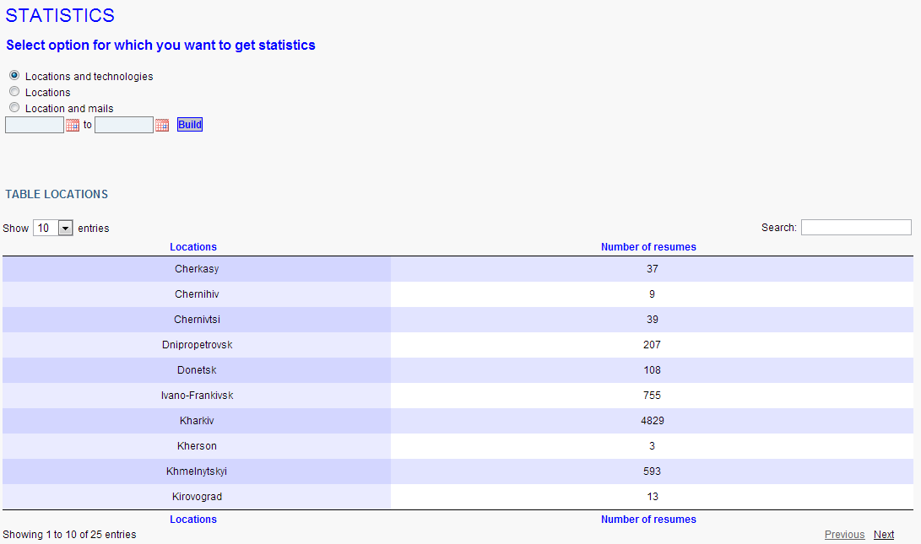
Statistics page redesign
Statistics page redesign using jQuery DataTable

Slide 19
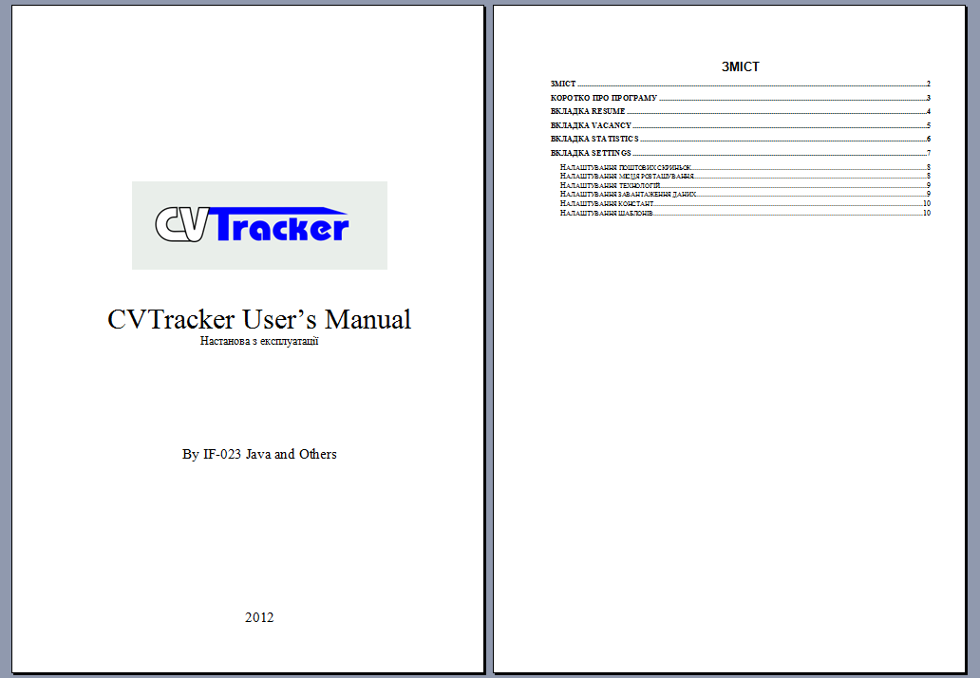
CVTracker Tasks
CVTracker User’s Manual

Slide 20
CVTracker: summary
What I have done:
Pop-Up window with resume preview;
CVTracker MD5 authorization;
Error messages;
Statistics business logic improvement;
Statistics page redesign;
Implementing vacancy page functionality;
CVTracker user’s manual

Slide 21

Questions, please…

Slide 22
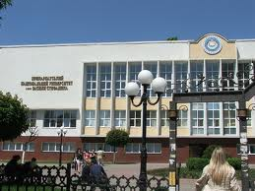
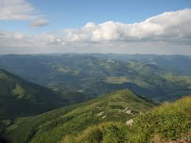



About me
My name is Olga Svyryd.
I am 24 years old.
Professional education: Precarpathian National University.
Department : Accounting and Audit.
I like:

Slide 23

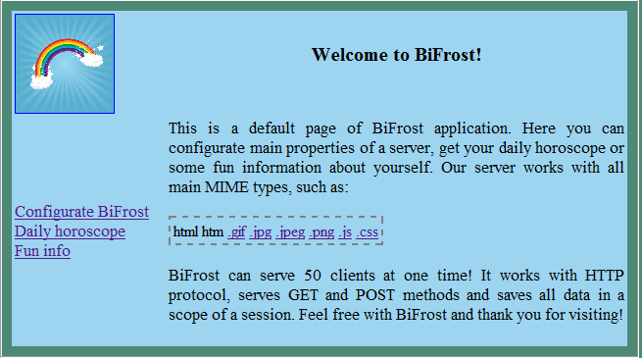
Web-Server
Web-Server core (managing pool of threads, socket’s connection, request getting and response sending logic implementation);
User Interface;
Sessions support and saving data in session scope;
Writing logs into database(using log4j);
Configuration Web-Server from xml file.

Slide 24
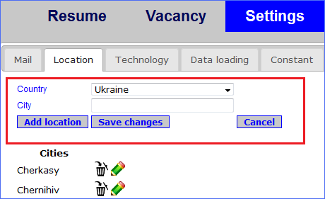
CVTracker, settings view JSP, JSTL, Spring
Problem – new locations couldn’t be added.
Solution – changing logic of saving city.

Slide 25
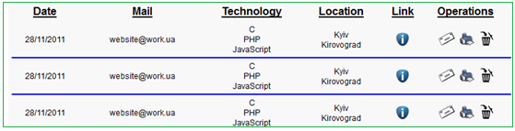
CVTracker, resumes duplication Hibernate
Problem – resume duplication during representation in main table.
Solution – adding ‘distinct’ statement into Hibernate query.

Slide 26
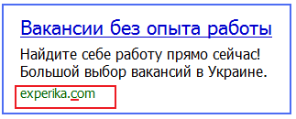
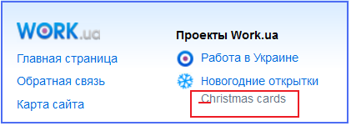
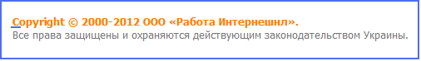
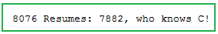
CVTracker, letters parsing RegExps
Problem – letters parsers worked not properly:
Solution – implementation parsers in accordance to appropriate web-site(5 parsers per web-site).

Slide 27
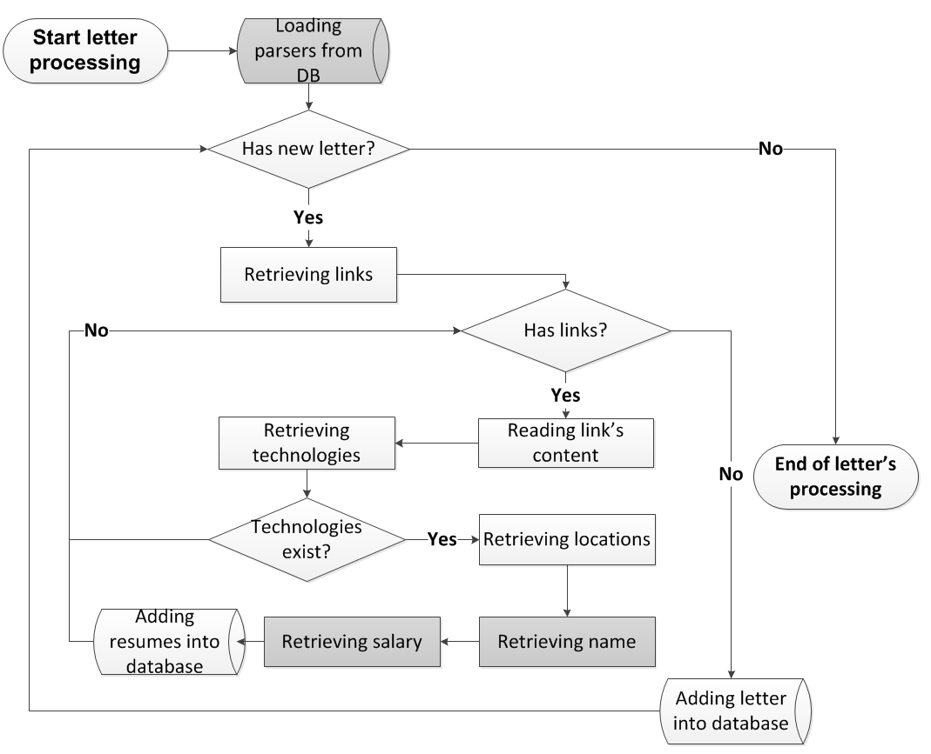
CVTracker: letters parsing

Slide 28
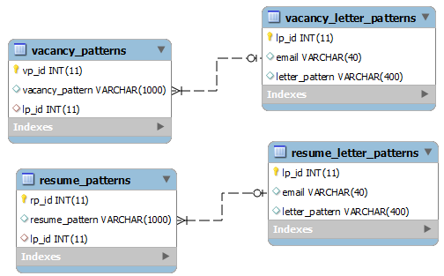
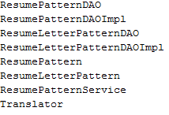
CVTracker, working with letters Hibernate, SQl
Adding necessary DAO, Service and Entity classes for saving patterns in database;
Adding appropriate tables in database.

Slide 29
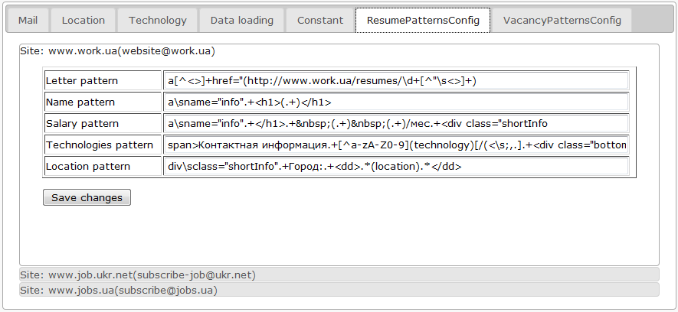
CVTracker, working with letters JSP, JSTL
Integration pattern logic into settings.jsp
Adding new tabs to customer’s view

Slide 30
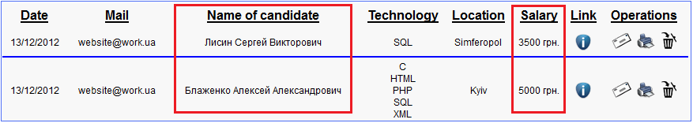
CVTracker SQL, JSP, JSTL
Implementing salary and name columns into main inbox table;
Before changes:
After changes:

Slide 31
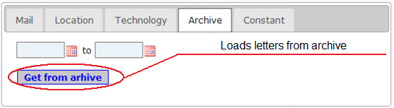
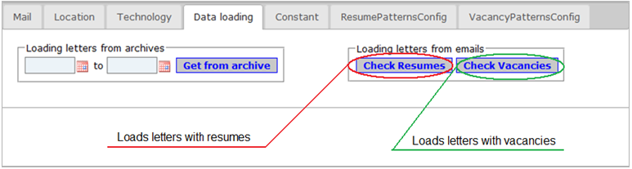
CVTracker JSP, JSTL, HTML
Redesigning settings.jsp view.
Before changes:
After changes:

Slide 32
CVTracker: summary
What I have done:
Resumes duplication fix;
New location adding fix;
Parsers writing;
Implementation logic of using new parsers;
Organization cycle of saving and using parsers;
Redesigning of settings.jsp.

Slide 33
Questions, please…

Slide 34
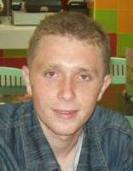
Personally information
Name: Rostyslav Apostol
Date of birth: 18 Sep 1989
Address: Kalush
Education:
National Technical University of oil and gas
Department: Oil- and gas pipelines
Department: Economic
My job:
Kalush department of exploiting of gas supplying systems
Oct 2010 – Apr 2012 – technical engineer
Apr 2012 – till now – leader of department of internal gas systems
My hobby:
Studying of foreign languages
Programming, mathematic
Spending time with my family
Notes:
34

Slide 35
BiFrost Server
What I have done?
Handling of requests (parsing GET-request from client);
Developing of UI;

Slide 36
CVTracker
What I have done?
UI features:
validation of input date;
validation of chosen mail servers;
Java features:
1) creating patterns for methods for parsing of resumes;
2) functionality for adding patterns for parsing of resumes
and vacancies into database;
3) functionality for testing resume and vacancy patterns;

Slide 37
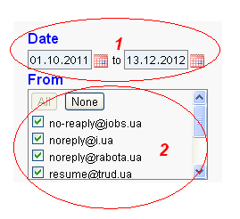
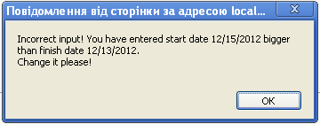
UI features Task1: validation of input date
AIM – validate input date.
SOLUTION – informing of the user by message that
a) the date field is empty; b) the start date is greater than the end one;
How does it look like?

Slide 38
UI features Task 2: validation of chosen mail servers
AIM – validate chosen mail servers.
SOLUTION – informing of the user by message that there are no chosen mail servers.
How does it work?
K1 = the number of existing checkboxes with name “eMails”
K2 = the number of unchecked checkboxes with name “eMails”
K1 = K2
NO
Sending request to Controller
Message “No chosen mail servers”
YES

Slide 39
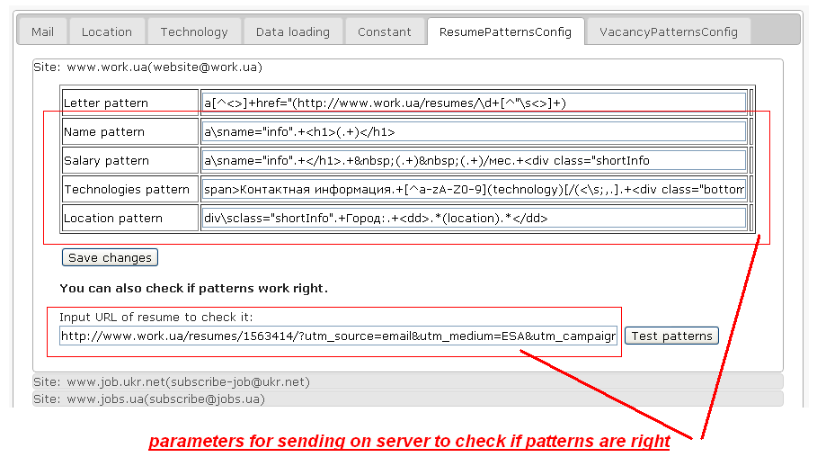
Java features Task 1: testing of patterns
AIM – to test if patterns are right for the site.
SOLUTION – adding text field for input URL of resume or
vacancy and button “Test patterns” with functionality describing bellow.
How does it look like?

Slide 40
Java features Task 1: testing of patterns
How does it work?

Slide 41
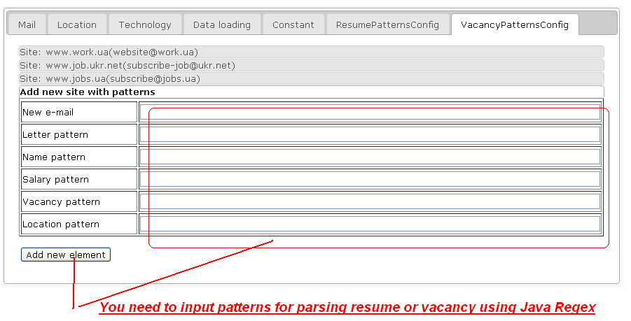
Java features Task 2: adding new patterns
AIM – to add new patterns for the site.
SOLUTION – adding new tab with text fields for input patterns and button
“Add new element” with functionality describing bellow.
How does it look like?

Slide 42
Java features Task 2: adding new patterns
How does it work?

Slide 43
Conclusion
My tasks
 | Tasks | The used technology
1 | Validation of input date | JavaScript
2 | Validation of chosen mail-servers | JavaScript
3 | Adding new patterns into database | Java
4 | Testing patterns | Java
Thank you for attention!

Slide 44
Questions, please…

Slide 45
About me
My name is Sergii Zaiats
I was born in 1984.
Professional education: Ivano-Frankivsk National Technical University of Oil and Gas, Department of Mechanical Engineering
Speciality : Mechanical Engineering
Now I work at “Intelkom”.
I like football and snowboarding.

Slide 46
WebServer
What I have done:
Graphical user interface (using Swing)
Tray icon
Writing logs to XML

Slide 47
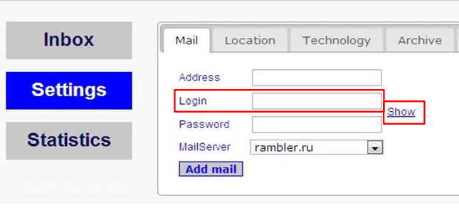
CVTracker
Old graphical user interface

Slide 48
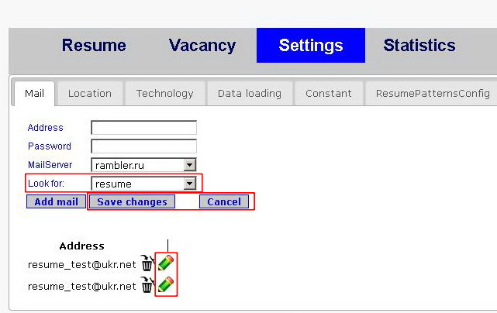
New GUI +edit feature+"Look for" input field

Slide 49
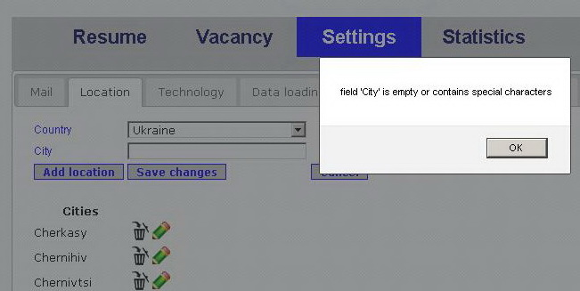
Validation
Validation to Mail, Location and Technology tabs in Settings menu

Slide 50
CVTracker: summary
What I have done?
GUI changes
Edit feature in Mail, Location and Technology tabs in Settings menu
New input to Settings->Mail (resume or vacancy dropdown list)
Validation

Slide 51
Questions, please…

Slide 52
About me
My name is Oleg Syvak.
In 2001 I graduated University of Oil and Gas in Ivano-Frankivsk.
I finished such trainings as: leading training and work in the team; trainings of writing projects for social organizations.
I was a volunteer in Maltese organization in Ukraine, now I take part in social work of our town.
I think, the profession of a programmer is progressive and useful for our society.
My hobbies are: painting, hiking in the Mounties. I am keen on informatics, mathematics, physics. I like also poetry and art.

Slide 53
The first team task
WEB SERVER
- Parsing XML-files.
Save/load information to a data base using JDBC.

Slide 54
My tasks
In the project I completed the tasks:
created module drop-down menu for inputting parser's patterns;
made progress bar for visualization lengthy process (loading letters from archive, parsing resumes).
implemented pool-threads for parsers.

Slide 55
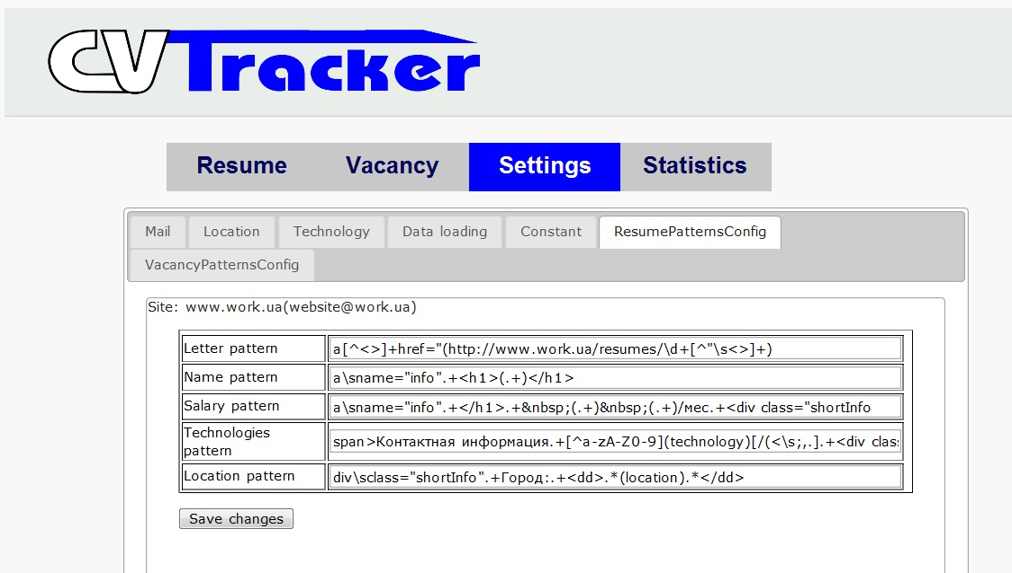
Module drop-down menu
Module drop-down menu has a hierarchical structure in multiple levels with an integrated categories and materials.
Inserting tags for input pattern and submit information.
Using jQuery Accordion.

Slide 56
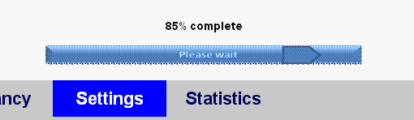
Progress bar
Please wait
Sometimes a task running within a program might take a while to complete (loading latter, parsing) .
Progress bar provides some indication to the user that the task is occurring, and how much work has already been done.
The progress bar was realized using it own controller, service and jsp-files.

Slide 57
Pool-threads
Threads speed up the work of parsers.
Pool-threads is a number of threads are created to perform a number of tasks, which are usually organized in a queue.
Allows reuse already established flows
Once creating flows.
Do not spend time on frequent create and delete thread.

Slide 58
Block diagram
Create pool
While resume`s link is present
no
All the threads complete
yes
Save result of the search
Create thread

Slide 59
Questions, please…

Slide 60
Name:
Ivan
Surname:
Dyda
Date of birth:
07/07/1985
Marriage:
Yes
Sport:
Soccer, volleyball, table tennis, swimming, ect.
Books
Sherlock Holmes, Dale Carnegie.
Films:
Criminal Minds, Two and a Half Men etc.
Interests:
Riddles, puzzles

Slide 61
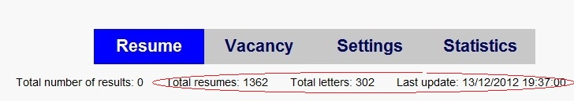
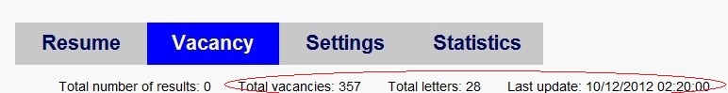
CVTracker
During the courses of SoftServe, I have mastered the Java programming methods such as junit, log4j, hibernate etc.
On the final task, a had to make statistics tabs in Resume, Vacancy bookmarks.

Slide 62
Questions, please…

Slide 63
About me
My name is Sergii Lamanov.
I was born in 1985.
Professional education: Ivano-Frankivsk National Technical University of Oil and Gas.
Speciality : Automated Control of the Technological Processes.

Slide 64

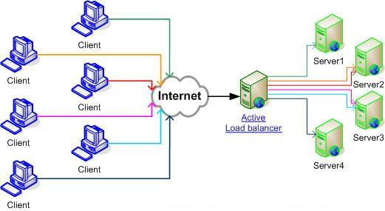
The first team task
Pokémon Web Server
My task was:
Load Balancer

Slide 65
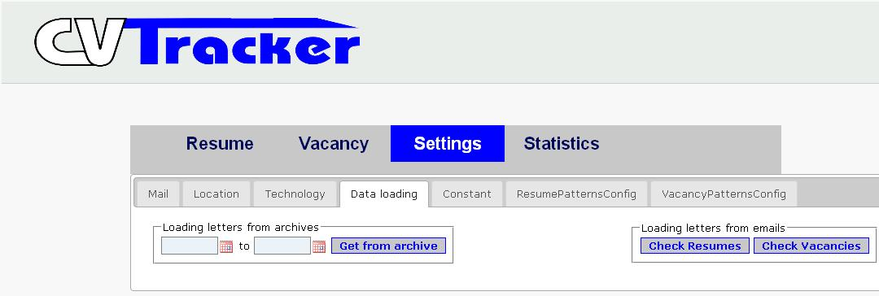

CVTracker, Settings low fixes

Slide 66


CVTracker, Inbox Checkboxes “Check all”, “Uncheck all” changed to buttons “All”, “None”.
Before changes:
After changes:

Slide 67

CVTracker, Settings, Updating time option

Slide 68
CVTracker, back-end Scheduler Service
Settings
JSP
Settings
Controller
Scheduler
Service
Constant
Service
Constant
DAO
Spring
Scheduler
updateConstant
changeCron
get
getConstant
update
setConstant
scheduledFuture.cancel(false);
scheduleTask
schedule
ScheduledFuture

Slide 69
Questions, please…

Slide 70



About Me
My name is Andryus Omelchenko
Im 25 years old.
Professional education: Institute of Management and Economics “Galician Academy”
Specialty: Programmer engineer
I like:

Slide 71
Pokémon WebServer
What I have done?
Handling of requests (parsing GET/POST-requests);
Adding Cookies

Slide 72

CVTracker

Slide 73

CVTracker

Slide 74

CVTracker

Slide 75
CVTracker: summary
What I have done?
Adding annotation for resumes
Adding priority

Slide 76
Questions, please…

Slide 77
Summary
Back-end
jUnit
Log4j
Core Java,
Java EE
Spring
Spring MVC
Spring Security
Hibernate
MySQL
Regular
expressions
Front-end
HTML
Javascript
jQuery
AJAX
CSS
Java Servlet Pages
JSP
JSTL
TOOLS
Ant
Apache Tomcat
Maven
SVN
JIRA
Eclipse IDE

Slide 78

CVTracker: demonstration

Slide 79
IF 023-Java
IF 023 Java
Volodymyr Ostapiv
Olga Svyryd
Rostyslav Apostol
Sergii Zaiats
Andrius Omelchenko
Oleg Syvak
Ivan Duda
Sergii Lamanov
18.12.2012

Slide 80

Thank You!

Slide 81



With a great respect to Yuriy Bezgachnyuk!

